Slide 1

Embedded System HW 03: Add modules into Linux Kernel & Install Linux Kernel
Department of Computer Science and Information Engineering
Shuo-Han Chen (陳碩漢), shchen@csie.ntut.edu.tw
Hong-Yue Technology Research Building 334
R 09:10 - 12:00
Notes:
Good Afternoon everyone
I am Shuo-Han Chen, a postdoctoral research fellow at Academia Sinica
It is a great honor to be invited by the department for being here today

Slide 2
Purpose for this Homework
Read the requirement of report carefully !
To recover from original HW03 setting, do the following at the source code folder
-> cd linux-5.9.2
-> cp -v /boot/config-$(uname -r) .config
Goal : Learn add your own module into Linux Kernel & install Kernel
Add your module to Linux Kernel Source
Find the hello world kernel module you wrote in HW01
Add your student ID to the print message
Copy hello_world.c into ./drivers/gpio/
Add config code into ./drivers/gpio/Kconfig
Add CONFIG into ./drivers/gpio/Makefile
2
Notes:
Here is more detail about me. I started working as a postdoctoral research fellow at the Institute of Information Science, Academia Sinica since March 2018
During my fellowship, I have been to the Purdue University USA and the Chinese University of Hong Kong for visiting
Before my fellowship, I spent two and half years for my phd degree at the CS Department of National Tsing Hua University
My research interests mainly lies in
the next generation memory/storage architecture designs
Emerging non-volatile memory and storage technologies
Low power system designs for artificial neural networks
In the past few years, I have revived few awards and a best paper nomination at DAC conference, which is a top rated conference in the EDA field

Slide 3
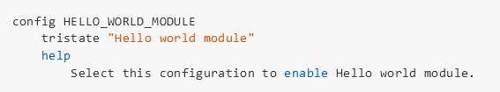
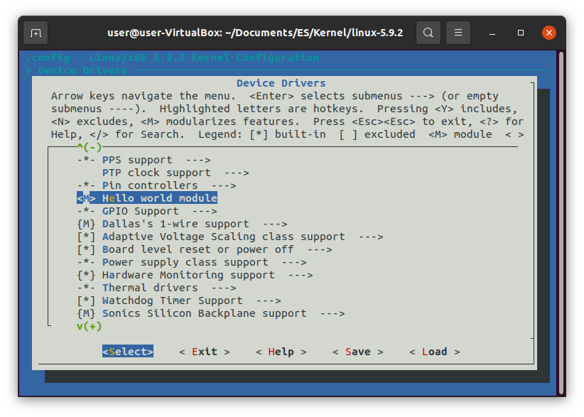
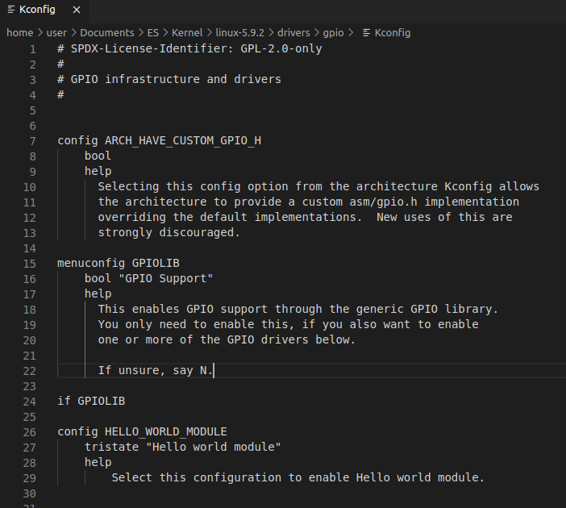
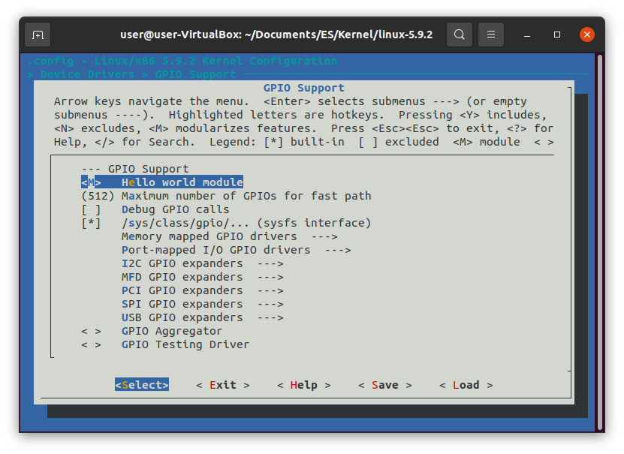
Add config code into ./drivers/gpio/Kconfig
Be careful the position in Kconfig. You will got the module in different place.(in menuconfig)

Slide 4
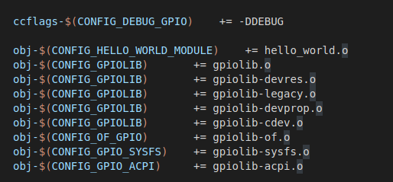
Add config code into ./drivers/gpio/Kconfig
Now it will appear in configuration menu. Use $make menuconfig and navigate to Device Drivers—>GPIO Support —> Hello World Module, enable it and save the config.
If you choose <M> module, you wiil need to use “modprobe hello_world” after you reboot your virtual machine.
If you choose <*> built-in, “hello world studentID” should be in your dmesg after you reboot your virtual machine.
Use $make to compile the kernel.

Slide 5
Install your compiled kernel
After recompile your kernel, in your Linux Kernel source folder
sudo make modules_install
sudo make install
Reboot and Find your print message in dmesg after your compiled kernel is installed.
Note: If you encounter “deadlock on memory” error after you reboot, you might need to increase the memory you assign to the virtual machine.
Reference:
https://kerneltweaks.wordpress.com/2013/11/26/add-new-module-to-linux-kernel-source-code/

Slide 6
Requirement of this Homework
Form and submit your report
Screenshot the console message of your compiled Linux Kernel
Screenshot the Hello World message from dmsg after your new Linux Kernel is installed
6
Notes:
Here is more detail about me. I started working as a postdoctoral research fellow at the Institute of Information Science, Academia Sinica since March 2018
During my fellowship, I have been to the Purdue University USA and the Chinese University of Hong Kong for visiting
Before my fellowship, I spent two and half years for my phd degree at the CS Department of National Tsing Hua University
My research interests mainly lies in
the next generation memory/storage architecture designs
Emerging non-volatile memory and storage technologies
Low power system designs for artificial neural networks
In the past few years, I have revived few awards and a best paper nomination at DAC conference, which is a top rated conference in the EDA field

Slide 7

Q & A
Remember to submit your report.
Deadline is set to 12/23 23:59 !
Late submission will be not accepted !
Notes:
Thank you for listening. Now, I would like to end today’s talk by the Q & A time.

